Slide 1
Modified Spider Monkey Optimization for Traveling Salesman Problem
Presented by
Safial Islam Ayon
1407041
Dept. of CSE, KUET
Supervisor
Dr. Muhammad Aminul Haque Akhand
Professor
Dept. of CSE, KUET

Slide 2
Outline
Spider Monkey in Nature
Spider Monkey Optimization (SMO) Algorithm
Modified SMO for Traveling Salesman Problem (TSP)
Result and Comparison
Conclusion

Slide 3
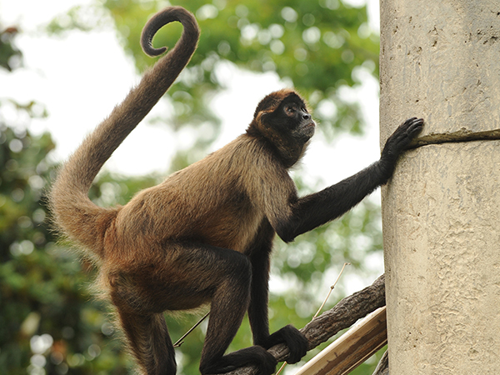
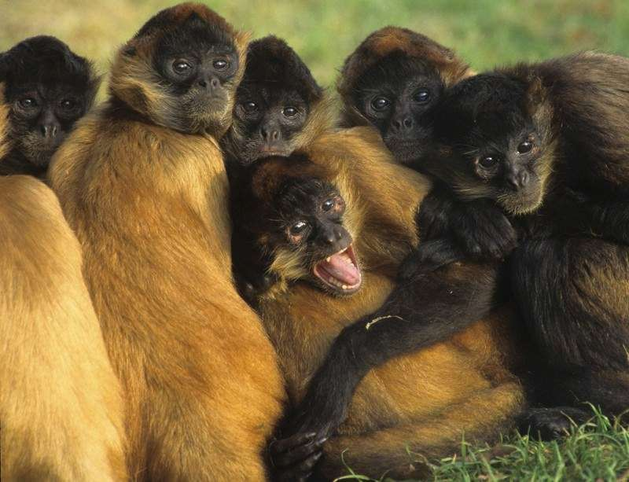
Introduction
Spider Monkey Optimization (SMO) algorithm is a population-based metaheuristics algorithm inspired by the social behavior of spider monkeys.
The social behavior of spider monkeys is an example of the fission-fusion system.
Standard SMO is developed for numerical or function optimization but this study modify the SMO to solve TSP.

Slide 4
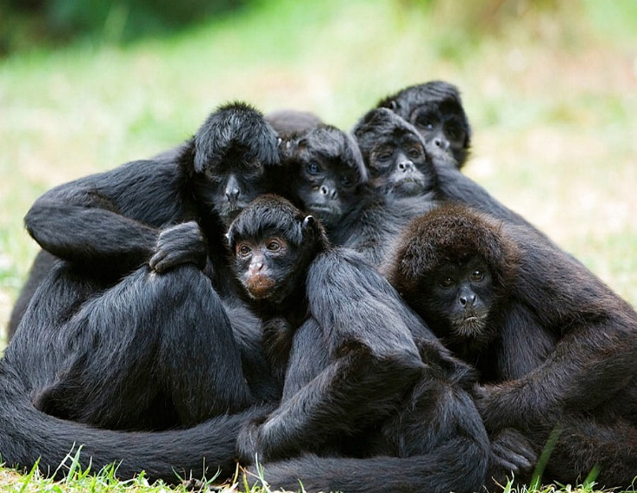
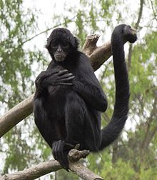
Characteristic of Spider Monkeys
Spider monkeys are Fission-Fusion Social Structure (FFSS) based animals.
The group leader divides the group into subgroups, if the group fails to get enough food.
The group members interact with each other by using visual and vocal communication.

Slide 5
SMO for FO: Group Divide and Combine
Main Group
At First GL and LL are Same
SubG1
SubG2
SubG3
……………
SubGn
……………
LL1
LL2
LL3
LLn
GL combine all the groups into a single group
GL
GL
GL
Main Group
GL = Global Leader; LL = Local Leader; n = Maximum no. of Group

Slide 6
SMO for FO: Position Update
In SMO, each Spider Monkey (SM) update its position based on Global Leader (GL), Local Leader (LL), and Randomly selected Spider Monkey (RSM).
Position updated Equation:
SMnewi = SMi + U[0,1] * (LLk – SMi) + U[-1,1] * (RSMk – SMi)
SMnewi = SMi + U[0,1] * (GL – SMi) + U[-1,1] * (RSMk – SMi)
LLk = Kth group Local Leader, GL = Global Leader, and RSMk = Randomly selected spider monkey in Kth group, U[0,1] = Uniformly distributed random number.

Slide 7
SMO for TSP
SMO found effective for solving engineering optimization problem.
This study investigates a new technique to solve TSP using SMO.
For solving TSP, every particle (i.e., spider monkey) is considered as a TSP solution i.e., complete tour.
The solution updating parameter is termed as Swap Sequence (SS) and Swap Operators (SO).
A SS may define as SS= (SO₁, SO₂, SO₃... So_{n}). A SO indicates two positions in the TSP solution that might be swap to get a new Solution.

Slide 8
SMO for TSP: Swap Operation
Suppose a tour of five cities is S= (l, 5, 3, 2, 4), and Swap Operator SO(1, 2), the new tour S’ is:
S’ = S + SO(1, 2)
= (1, 5, 3, 2, 4) + SO(1, 2)
= (5, 1, 3, 2, 4)
Here, ‘+’ means to apply the SO in the solution.
The Swap Sequence may also get from solutions S1 and S2 in the following equation.
SS = S2 – S1 = (SO1, SO2, SO3, …, SOn)
1
1
5
5
2
2
4
4
3
3

Slide 9
SMO for TSP: Update though Partial Search
In Partial Search (PS), apply SO of SS and final output is a portion or full SS which give best tour.
Suppose a solution is S = (1 – 3 – 2 – 5 – 4) and SS = {SO (2,3), SO (1,2), SO (4,5)}.
Apply Swap Sequence | New Solution | Function Value
(1 – 3 – 2 – 5 – 4) + SO (2,3) | (1 – 2 – 3 – 5 – 4) | f(x) = 18.17
(1 – 2 – 3 – 5 – 4) + SO (1,2) | (2 – 1 – 3 – 5 – 4) | f(x) = 21.45
(2 – 1 – 3 – 5 – 4) + SO (4,5) | (2 – 1 – 3 – 4 – 5) | f(x) = 19.82
In PS, solution with the lowest value 18.17 for (1 – 3 – 2 – 5 – 4)
is considered as the updated solution.

Slide 10
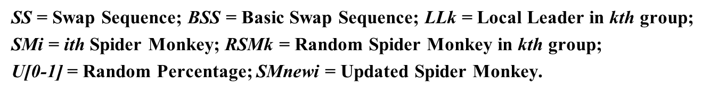
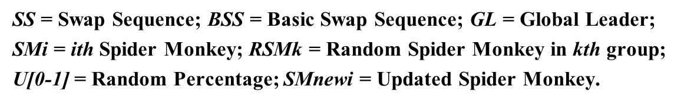
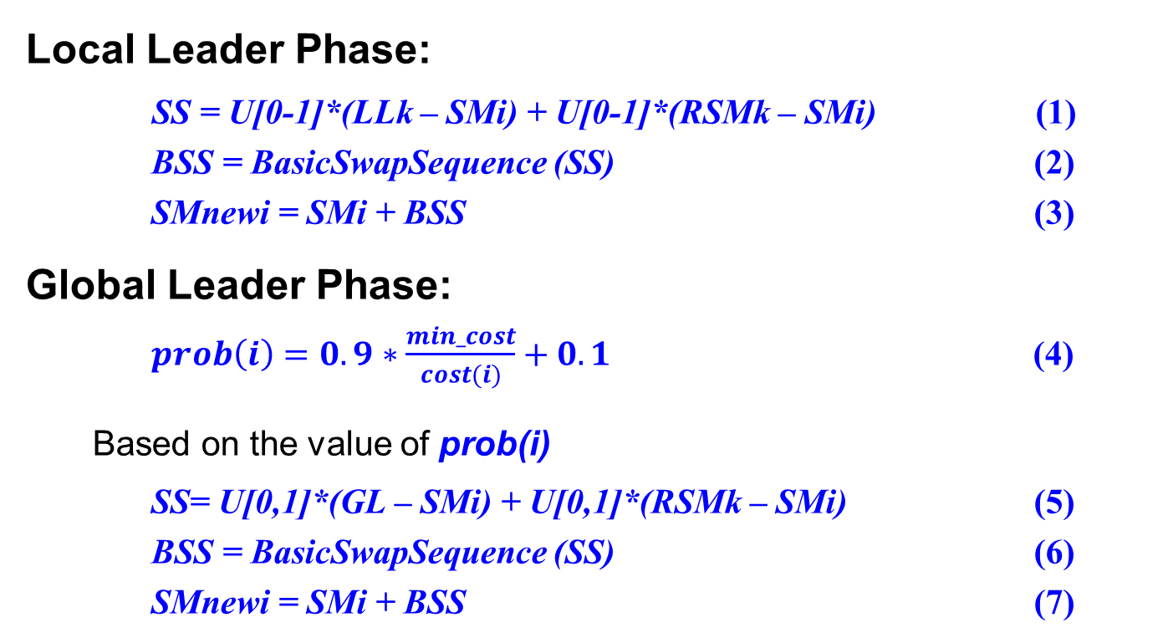
SMO for TSP: Solution Update
Local Leader Phase:
SS = U[0-1]*(LLk – SMi) + U[0-1]*(RSMk – SMi) (1)
BSS = BasicSwapSequence (SS) (2)
SMnewi = SMi + BSS (3)
Global Leader Phase:
$prob\left(i\right)=0.9∗\frac{min_cost}{cost(i)}+0.1$ (4)
Based on the value of prob(i)
SS= U[0,1]*(GL – SMi) + U[0,1]*(RSMk – SMi) (5)
BSS = BasicSwapSequence (SS) (6)
SMnewi = SMi + BSS (7)

Slide 11
SMO for TSP: Solution Update (Graphical)
SM
C1
C2
…
C4
LL/GL
LL/GL
C1
C1
C2
C2
…
…
C4
C4
RSM
C1
C2
…
C4
Swap Sequence of SM and LL/GL
Swap Sequence of SM and LL
Swap Sequence of SM and RSM
Merge Swap Sequence
Calculate Basic Swap Sequence
Apply the Swap Sequence and Select the Best result

Slide 12
SMO for TSP: Local and Global Leader Update
Local Leader Learning Phase:
Update the Local Leaders in every groups.
If the Local Leader is not modified, then LocalLimitCount of this group is incremented by 1.
Global Leader Learning Phase:
Update the Global Leader in the population.
If the Global Leader is not modified, then GlobalLimitCount is incremented by 1.

Slide 13
SMO for TSP: Decision Phase
Local Leader Decision Phase:
If the Local Leader is not updated for a specific time, then
1. Update the Spider Monkeys position randomly; or
2. The following Eq.
SMnewi = SMi + U[0,1] *(GL – SMi) + U[0,1] * (SMi – LLk)
Global Leader Decision Phase:
If the Global Leader is not updated for a specific time, then
1. Global Leader splits the population into small groups until Maximum Number of Group is reached; or
2. When Maximum Number of Group is reached, then the Global Leader joins all the groups into one group.

Slide 14
SMO for TSP: Generate Swap Sequence
Suppose,
SMi = LLk =
RSMk = =
3
7
6
9
2
4
10
5
8
1
9
6
7
3
2
4
10
5
8
1
9
3
8
10
1
2
4
5
7
6
| LLk - SMi |
9
6
7
3
2
4
10
5
8
1
-
3
7
6
9
2
4
10
5
8
1
(1,4), (2,3)
|RSMk - SMi |
9
3
8
10
1
2
4
5
7
6
-
3
7
6
9
2
4
10
5
8
1
(3,2), (1,7), (2,7), (3,9), (5,10), (6,10), (7,10), (1,4)

Slide 15
SMO for TSP: Calculate Swap Operators
SS = U[0-1]*(LLk – SMi) + U[0-1]*(RSMk – SMi)
SS = U[0 - 1] * {(1,4), (2,3)} + U[0 - 1] * {(3,2), (1,7), (2,7), (3,9), (5,10), (6,10), (7,10), (1,4)}
Suppose, U[0 – 1] = 0.5, and U[0 – 1] = 0.3.
SS = (0.5 * {(1,4),(2,3)} + 0.3 * {(3,2), (1,7), (2,7), (3,9), (5,10), (6,10), (7,10), (1,4)})
SS = (2,3), (3,2), (1,7), (2,7), (3,9), (1,4)
BSS = BasicSwapSequence (SS)
= BasicSwapSequence ((3,2), (2,3), (1,7), (2,7), (3,9), (1,4))
= (1,7), (2,7), (3,9), (1,4)

Slide 16
SMO for TSP : Solution Update
3
3
3
3
3
3
9
9
9
9
7
9
7
7
7
7
9
7
2
2
2
2
2
2
10
10
10
10
SMnewi = SMi + BSS
SMi =
BSS = (1,7), (2,7), (3,9), (1,4)
10
10
1
1
1
1
1
6
1
6
6
6
6
8
8
8
8
5
8
5
5
5
5
6
8
5
4
4
4
4
3
7
6
9
2
4
10
5
8
1
4
4
3
7
6
9
2
4
10
5
8
1
∫(x) 51.36
(1,7)
∫(x) 44.06
10
3
6
9
2
4
7
5
8
1
∫(x) 44.06
10
7
6
9
2
4
3
5
8
1
(2,7)
10
3
6
9
2
4
7
5
8
1
∫(x) 44.31
(3,9)
10
3
8
9
2
4
7
5
6
1
∫(x) 44.50
(1,4)
9
3
8
10
2
4
7
5
6
1
∫(x) 47.87

Slide 17
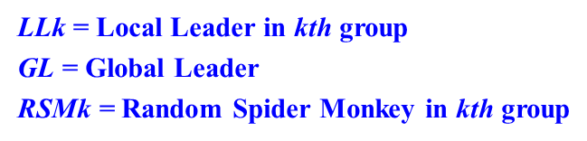
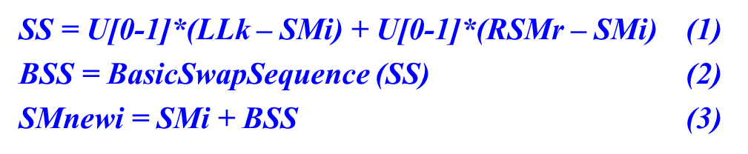
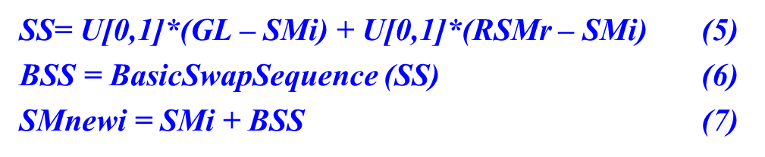
SMO for TSP: Algorithm
Step 1: Initialization the population
Step 2: Select GL and LLk of the kth group
Step 3: For each solution SMi in the kth group
a. Update Solution SMi based on LLk and RSMk using Eq. (1), Eq. (2) and Eq. (3).
b. Based on the prob(i), Update Solution SMi based on GL and RSMk using Eq. (5), Eq. (6) and Eq. (7).
c. Update LLk and GL.
d. Decision for Initialization or Divide the population or combine all groups
Step 4: If (termination condition is not met), Goto Step 3
Step 5: The global Supreme Leader GL will be considered as the best result

Slide 18
Comparison of Average result for 20 runs
Problem | ACO | VTPSO | SMO
Eil51 | 503.41 | 442.33 | 433.64
Berlin52 | 8061.64 | 7865.36 | 7556.91
KroA100 | 24667.6 | 22138.5 | 21593.2
KroB100 | 25354.4 | 23228.3 | 22864.0
Eil101 | 739.53 | 672.22 | 673.11
Pr136 | 110946.3 | 102945.7 | 102872
KroA150 | 31170.42 | 28262.98 | 28354.09
U159 | 47615.78 | 45441.55 | 42598.3
KroB200 | 35109.8 | 31923.15 | 31781.62
Tsp225 | 4544.82 | 4210.65 | 4162.79
Gil262 | 2787.01 | 2631.69 | 2627.87
Lin318 | 48583.74 | 46209.53 | 45460.25
Fl417 | 13618.22 | 12980.24 | 12950.77
D493 | 39789 | 38159.18 | 37861.14
Population size: 100 and Number of Generation: 500.

Slide 19
Comparison of Best result for 20 runs
Problem | ACO | VTPSO | SMO
Eil51 | 461.42 | 428.98 | 431.43
Berlin52 | 7870.45 | 7544.37 | 7545.14
KroA100 | 24524.53 | 21438.19 | 21486.69
KroB100 | 24675.03 | 22648.29 | 22499.02
Eil101 | 729.95 | 663.28 | 663.28
Pr136 | 110872.2 | 99247.01 | 97538.68
KroA150 | 30546.06 | 27232.1 | 27591.44
U159 | 47514.43 | 43579.82 | 42598.3
KroB200 | 34207.79 | 30767.52 | 30716.5
Tsp225 | 4396.39 | 4095.01 | 4013.68
Gil262 | 2730.52 | 2547.16 | 2543.15
Lin318 | 47442.95 | 44724.38 | 44118.60
Fl417 | 13296.85 | 12376.53 | 12218.98
D493 | 39254 | 37132.09 | 36844.63
Population size: 100 and Number of Generation: 500.

Slide 20
Analysis: Variation Effect of Population on Eil76
SMO shows better performance than ACO and VTPSO

Slide 21
Analysis: Effect of Total Iteration on Eil76
SMO shows better performance than ACO and VTPSO

Slide 22
Conclusion
SMO is modified to solve TSP which is a mainly a combinatorial optimization task.
Swap Sequence and Swap Operators based operation is developed for TSP.
The proposed SMO for TSP showed better performance in most of the cases compared to ACO and VTPSO.

Slide 23
Thanks for your attention
Question and Answer

